Slide 1

Categorical variables: Data exploration, visualization and tests of independence
Natalia Levshina © 2017

Slide 2
Outline
1. Categorical data: exploration and visualization
2. Associations between categorical variables:
- measures of association
- the chi-squared test
- Fisher exact test

Slide 3
2 ways to tabulate a variable
> attach(ELP)
> summary(POS)
JJ NN VB
159 532 189
> table(POS)
POS
JJ NN VB
159 532 189

Slide 4
Proportions and percentages
> prop.table(table(POS))
POS
JJ NN VB
0.1806818 0.6045455 0.2147727
> prop.table(table(POS))*100
POS
JJ NN VB
18.06818 60.45455 21.47727

Slide 5
Bar plot with counts
> barplot(table(POS))
A fancier version:
> barplot(table(POS), col = "blue", main = "Frequencies of POS", ylab = "Frequency")

Slide 6
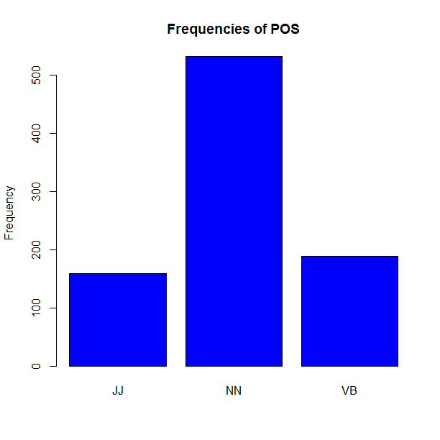

Slide 7
Bar plot with proportions
> barplot(prop.table(table(POS)), col = "blue", main = "Proportions of POS", ylab = "Proportion")

Slide 8


Slide 9
Pie chart
> pie(table(POS), col = c("violet", "blue", "lightblue"))

Slide 10
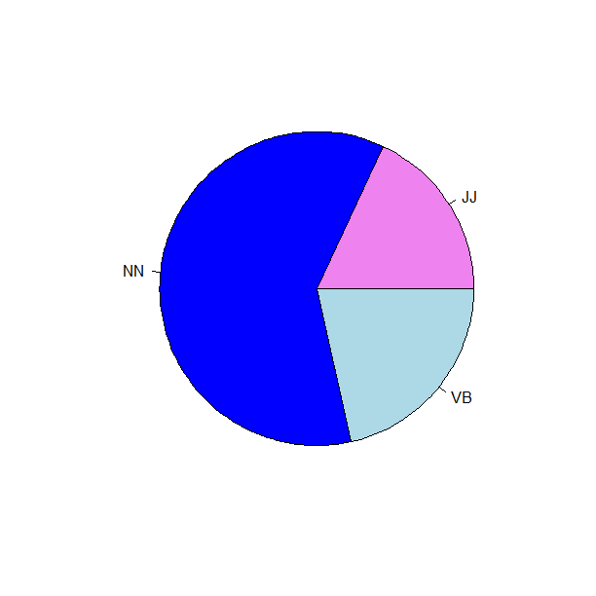

Slide 11
Exercise: Your colours
Create a factor with your and your fellow students’ favourite colours.
Compute the proportions of each of the colours. Which one is the most popular in the group?
Create a pie chart with the colours corresponding to each colour category.

Slide 12
Nerds and geeks
> str(nerd)
'data.frame': 1316 obs. of 5 variables:
$ Noun : Factor w/ 2 levels "geek","nerd": 2 2 2 2 2 2 2 2 2 2 ...
$ Num : Factor w/ 2 levels "pl","sg": 1 1 1 1 1 1 1 1 1 1 ...
$ Century : Factor w/ 2 levels "XX","XXI": 1 2 1 1 1 2 2 1 2 1 ...
$ Register: Factor w/ 4 levels "ACAD","MAG","NEWS",..: 1 1 1 1 1 1 1 1 1 1 ...
$ Eval : Factor w/ 3 levels "Neg","Neutral",..: 2 2 2 2 2 2 2 2 2 2 ..

Slide 13
Noun by Century
> attach(nerd)
> table(Noun, Century)
Century
Noun XX XXI
geek 197 473
nerd 318 328

Slide 14
Proportions for two-dimensional tables
> prop.table(table(Noun, Century)) #all cells sum up to 1
Century
Noun XX XXI
geek 0.1496960 0.3594225
nerd 0.2416413 0.2492401
> prop.table(table(Noun, Century), 1) #rows sum up to 1
Century
Noun XX XXI
geek 0.2940299 0.7059701
nerd 0.4922601 0.5077399
> prop.table(table(Noun, Century), 2) #columns sum up to 1
Century
Noun XX XXI
geek 0.3825243 0.5905119
nerd 0.6174757 0.4094881

Slide 15
Bar plots with 2 variables
> barplot(table(Noun, Century), col = c("blue", "lightblue"))
> legend("topleft", legend = c("geek", "nerd"), fill = c("blue", "lightblue"))

Slide 16
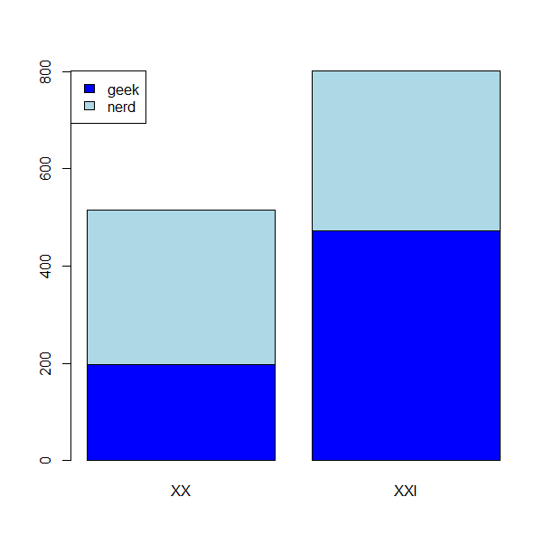

Slide 17
Bar plots with unstacked bars
> barplot(table(Noun, Century), col = c("blue", "lightblue"), beside = TRUE)
> legend("topleft", legend = c("geek", "nerd"), fill = c("blue", "lightblue"))

Slide 18
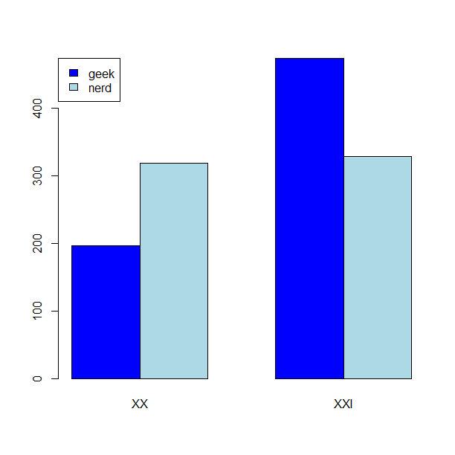

Slide 19
Outline
1. Categorical data: exploration and visualization
2. Associations between categorical variables:
- measures of association
- the chi-squared test
- Fisher exact test

Slide 20
Effect size for categorical data
One can see that nerd occurs more often in the XX century data than in the XXI century data. For geek, it is the other way round.
One speaks about an association between two categorical variables.
How strong is that effect?
One of the popular measures of effect size is odds ratio.

Slide 21
Odds and odds ratio
> table(Noun, Century)
Century
Noun XX XXI
geek 197 473
nerd 318 328
Odds geek to nerd in XX = 197/318 = 0.62
Odds geek to nerd in XXI = 473/328 = 1.44
Odds ratio (OR) = 0.62/1.44 = 0.43

Slide 22
How to interpret odds?
If odds = 1, there is no difference in the probabilities of both outcomes (i.e. geek and nerd).
If odds > 1, the probability of the first outcome (geek) is greater than the probability of the second outcome (nerd).
If odds < 1, the probability of the first outcome (geek) is smaller than the probability of the second outcome (nerd).
Odds ratio = 1 means no difference in the odds. No association between the variables.
Odds ratio > 1 means that the first odds are greater than the second odds.
Odds ratio < 1 means that the first odds are smaller than the second odds.

Slide 23
A cliché example
Imagine you have 10 Belgian friends and 10 German friends. 9 of the Belgians love Belgian beers, and only 1 hates them. 9 of the German friends hate Belgian beers, and only 1 loves them.
Odds of love to hate for Belgians are 9/1 = 9, and for Germans 1/9 = 0.11
Odds ratio is 9/0.11 = 81. This is a very strong effect.
 | Belgian | German
Loves | 9 | 1
Hates | 1 | 9

Slide 24
Does the order matter?
Let’s swap the columns:
OR = 0.11/9 = 0.0123
But this is the inverse of 81!
1/81 = 0.0123
If an association is strong, the OR is either very close to 0 (for OR < 1), or very large (for OR > 1).
 | German | Belgian
Loves | 1 | 9
Hates | 9 | 1

Slide 25
Other statistics for effect size
> library(vcd)
> assocstats(table(Noun, Century))
X^2 df P(> X^2)
Likelihood Ratio 54.653 1 1.4388e-13
Pearson 54.258 1 1.7586e-13
Phi-Coefficient : 0.203
Contingency Coeff.: 0.199
Cramer's V : 0.203

Slide 26
Hypothesis
Here, the odds of geek against nerd in the XX century data are smaller than the same odds in the XXI century data.
But is the difference statistically significant?
Null hypothesis: there is no difference between the odds of geek against nerd in the two centuries. Or there is no association between the nouns and the centuries.
Alternative hypothesis: there is a difference between the odds of geek to nerd. Or one can say there is an association between the nouns and the centuries.
Note: for categorical data, it is more conventional to use non-directional hypotheses.

Slide 27
Outline
1. Categorical data: exploration and visualization
2. Associations between categorical variables:
- measures of association
- the chi-squared test
- Fisher exact test

Slide 28
Chi-squared test
> chisq.test(table(Noun, Century))
Pearson's Chi-squared test with Yates' continuity correction
data: table(Noun, Century)
X-squared = 53.429, df = 1, p-value = 2.681e-13

Slide 29
What is the Chi-squared statistic?
A sum of squared deviations of the observed frequencies from the expected values divided by the expected values.
The greater the deviations, the more reasons to believe that something’s going on.
The expected values are those if there is no association between the variables.
> chisq.test(table(Noun, Century))$expected
Century
Noun XX XXI
geek 262.196 407.804
nerd 252.804 393.196

Slide 30
Understanding expected frequencies
> barplot(chisq.test(table(Noun, Century))$expected, col = c("blue", "lightblue"), main = "Expected frequencies")
> legend("topleft", legend = c("geek", "nerd"), fill = c("blue", "lightblue"))

Slide 31
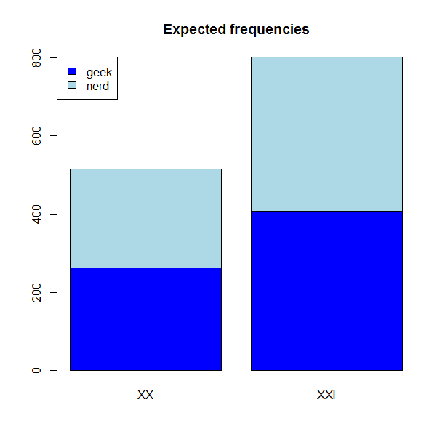

Slide 32
What are degrees of freedom?
Degrees of freedom are necessary for computing the p-value.
For a x by y table, this is x – 1 multiplied by y – 1
If it’s a 2 x 2 table, then (2 – 1) x (2 – 1) = 1
If it’s a 3 x 3 table, then (3 – 1) x (3 – 1) = 4
They show how many cells in the table we can change without changing the row and column sums. In our case, we can only change one cell in the table (try it out!).

Slide 33
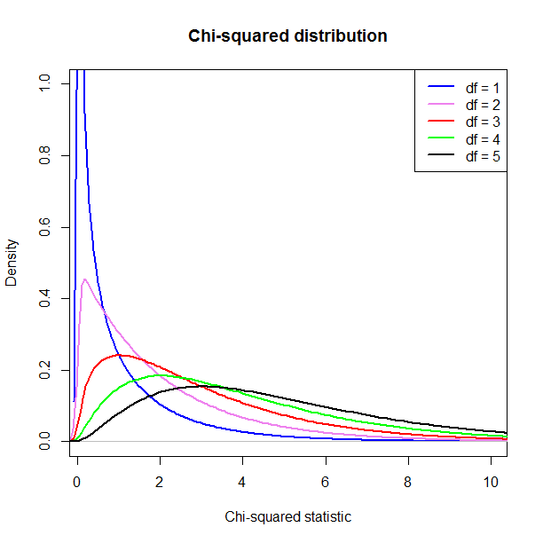

Slide 34
Interpretation of the results
A p-value for continuous statistics (like the Chi-squared) is computed as the proportion of the area with the given and more extreme values under the curve that corresponds to the degrees of freedom. All area = 1.
Obviously, this area for Chi-squared ≥ 53 is tiny.
More exactly, p = 2.681e-13, i.e. 0.0000000000002681.
It’s highly unlikely to find this result by chance!
We can safely reject the null hypothesis of no association.

Slide 35
Exercise
Do nerd and geek differ with regard to their positive or negative evaluation? In other words, is there an association between the variables Noun and Eval?
Make a bar plot.
What is the expected frequency of nerd with negative evaluation? Is it larger or smaller than the observed frequency?
What is the expected frequency of geek with positive evaluation? Is it larger or smaller than the observed frequency?
How many degrees of freedom does the table have?
Perform the Chi-squared test and interpret it. Can you reject the null hypothesis of no association?

Slide 36
Outline
1. Categorical data: exploration and visualization
2. Associations between categorical variables:
- measures of association
- the chi-squared test
- Fisher exact test

Slide 37
Fisher exact test
FET should be used in those situations when one of the expected frequencies is less than 5.
The Chi-squared test becomes unreliable, and you get a warning.

Slide 38
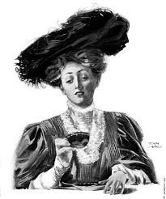
The Fisher exact test: The story
A biologist, Ph.D. B. Muriel Bristol-Roach, claimed that tea tasted better if the milk is added before the tea. She said she could tell the difference.
To test this, Fisher devised an experiment:
He gave her 8 cups of tea. In 4, the milk was added before, and in the other 4, after.
Can she tell which cups is which, knowing that 4 + 4?

Slide 39
The tea challenge
She got all eight correct!
Is it due to chance, or can Dr. Bristol really tell the difference?
 | Said “tea first” | Said “milk first”
Tea first | 4 | 0
Milk first | 0 | 4

Slide 40
Data set tea
> tea <- rbind(TeaFirst = c(4, 0), MilkFirst = c(0, 4))
> colnames(tea) <- c("Said_Tea", "Said_Milk")
> tea
Said_Tea Said_Milk
TeaFirst 4 0
MilkFirst 0 4

Slide 41
The Chi-squared test is not reliable
> chisq.test(tea)
Pearson's Chi-squared test with Yates' continuity correction
data: tea
X-squared = 4.5, df = 1, p-value = 0.03389
Warning message:
In chisq.test(tea) :
Chi-squared approximation may be incorrect

Slide 42
Some combinatorics
Suppose she had 0 correct guesses:
There is only one 1 possible combination.
 | Cup 1 | Cup 2 | Cup 3 | Cup 4 | Cup 5 | Cup 6 | Cup 7 | Cup 8
Actual | T | T | T | T | M | M | M | M
Response | M | M | M | M | T | T | T | T

Slide 43
Some combinatorics
If she had 1 correct guess where tea was first, there are 16 possible combinations, e.g.
 | Cup 1 | Cup 2 | Cup 3 | Cup 4 | Cup 5 | Cup 6 | Cup 7 | Cup 8
Actual | T | T | T | T | M | M | M | M
Response | T | M | M | M | M | T | T | T
 | Cup 1 | Cup 2 | Cup 3 | Cup 4 | Cup 5 | Cup 6 | Cup 7 | Cup 8
Actual | T | T | T | T | M | M | M | M
Response | M | T | M | M | M | T | T | T
And so on…

Slide 44
Some combinatorics
If she had 2 correct guesses where tea was first, there are 36 possible combinations, e.g.
 | Cup 1 | Cup 2 | Cup 3 | Cup 4 | Cup 5 | Cup 6 | Cup 7 | Cup 8
Actual | T | T | T | T | M | M | M | M
Response | T | T | M | M | M | M | T | T
 | Cup 1 | Cup 2 | Cup 3 | Cup 4 | Cup 5 | Cup 6 | Cup 7 | Cup 8
Actual | T | T | T | T | M | M | M | M
Response | M | T | T | M | M | M | T | T
And so on…

Slide 45
Some combinatorics
If she guesses 3 cups where the tea was added first, there are again 16 combinations (if you don’t believe, try it out!).
A terribly difficult question: How many combinations are there for guessing correctly?

Slide 46
Permutations
In total, we have
1 + 16 + 36 + 16 + 1 = 70 possible combinations, or permutations.
There is only one combination when all cups are guessed correctly.
P = 1/70 ≈ 0.0143
This is the exact p-value for a one-tailed test.

Slide 47
FET in R (one-tailed)
> fisher.test(tea, alternative = "greater")
Fisher's Exact Test for Count Data
data: tea
p-value = 0.01429
alternative hypothesis: true odds ratio is greater than 1
95 percent confidence interval:
2.003768 Inf
sample estimates:
odds ratio
Inf

Slide 48
FET in R (two-tailed)
> fisher.test(tea)
Fisher's Exact Test for Count Data
data: tea
p-value = 0.02857
alternative hypothesis: true odds ratio is not equal to 1
95 percent confidence interval:
1.339059 Inf
sample estimates:
odds ratio
Inf

Slide 49
Take-home messages
Use visualization tools.
For 2 by 2 tables, report the odds ratio (effect size measure). Unfortunately, it doesn’t make sense for larger tables.
If one of your expected frequencies is smaller than 5, use the Fisher Exact Test.
There’s no harm in using FET in other situations if you have not too many counts in total.

